Slide 1
Instant Paperless Services Management System for a University
Start Date : 01-02-2020 .
By : Abdullah Al Khadeer
Supervisor : Dr. Zeeshan Khan .

Slide 2
Motivation
Kingdom of Saudi Arabia is moving towards paperless country by computerizing most of its processes.
Banks, Ministries, Government Department, Universities etc. have already computerized many of their processes.
Vision 2030 targets to have Kingdom of Saudi Arabia in the technologically advanced countries.

Slide 3
Abstract
Currently Mustaqbal University is using a paper based processes for faculty services and credit transfer. This paper based system results in
Wastage of resources
Slow decision making process
Late responses
Loss of documents
Management of documents etc.
In this project a paperless services management system is developed to computerize :
Faculty services
Credit Transfer Cases

Slide 4
Outline
Objectives
Scope
Modules
Design
Implementations
Conclusion and Future work

Slide 5
Objectives
Aim of the work is to :
Fasten the decision making process and save time
Utilize the resources properly
Prevent the loss of documents and enhance management of documents
Obtain up-to-date reports with one click
Have efficient communication

Slide 6
Modules
Credit Transfer
Filling electronic forms for credit transfer
Attaching student’s transcripts
Approving credit transfer cases
Completing and entering equalized courses
Approving equalized courses from HoD and Dean
Communicating the Student Affair regarding completed cases
Communicating the student regarding completed cases

Slide 7
Modules (Count)
Short Leave Request
Fill short leave request
Approve short leave request from HoD
Approve short leave request from Dean
Inform HR department regarding short leave
Full Leave Request
Fill Full leave request
Approve Full leave request from HoD
Approve Full leave request from Dean
Inform HR department regarding Fullt leave

Slide 8
Modules (Count)
Report an IT Problem
Report a Financial Problem
Request for ID (Iqama) Renewal
Request for Exit Re-Entry from Kingdom

Slide 9
Project Design
UML design for the main processes of the system
Use case diagrams
Activity diagrams
Sequence diagrams
Database design
Interface design

Slide 10
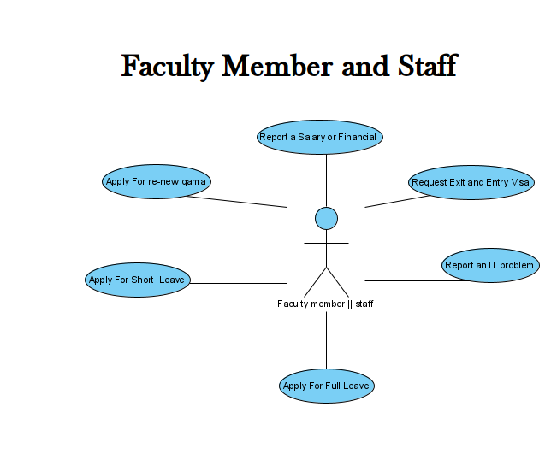
Use Case Diagrams

Slide 11
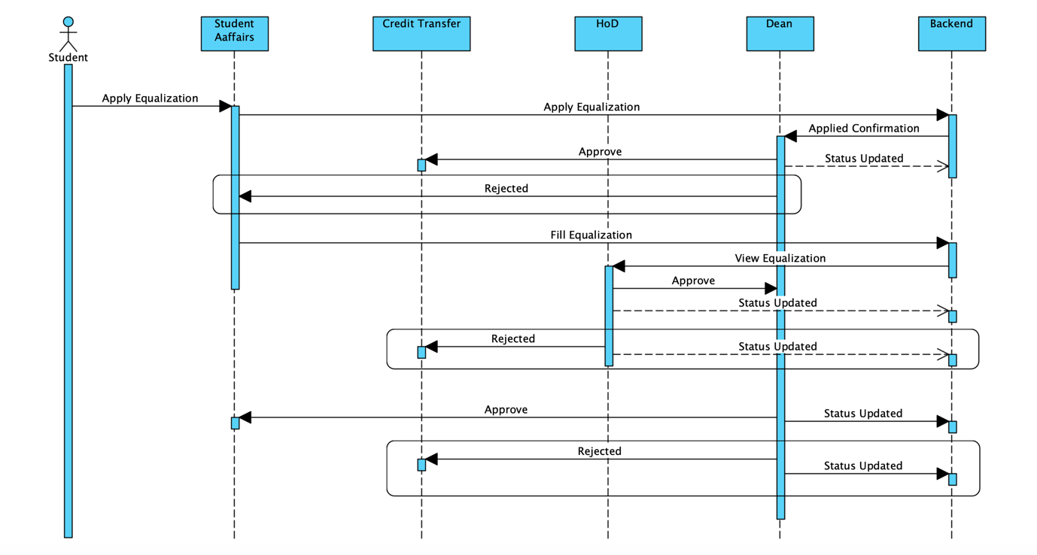
Sequence Diagrams

Slide 12
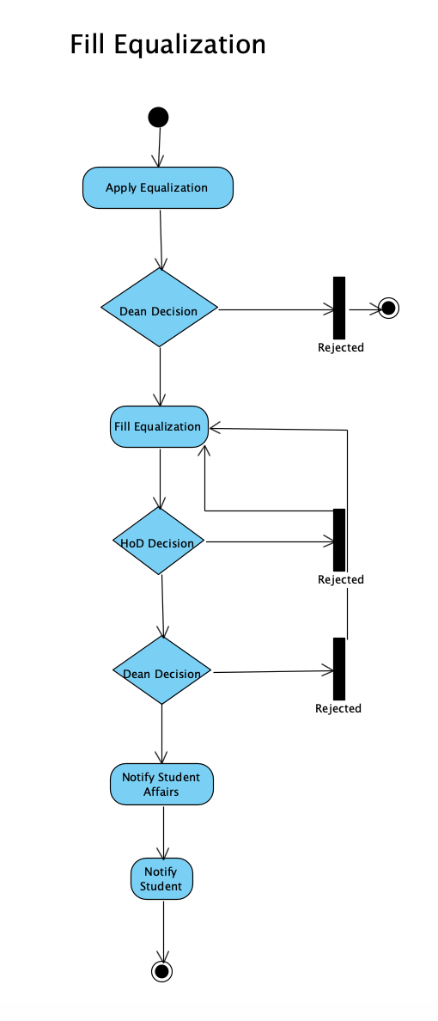
Activity Diagram

Slide 13
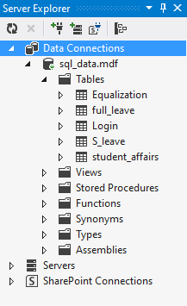
Database Design
SQL server is used as backend to store data
Database is created and tables are developed inside the database

Slide 14
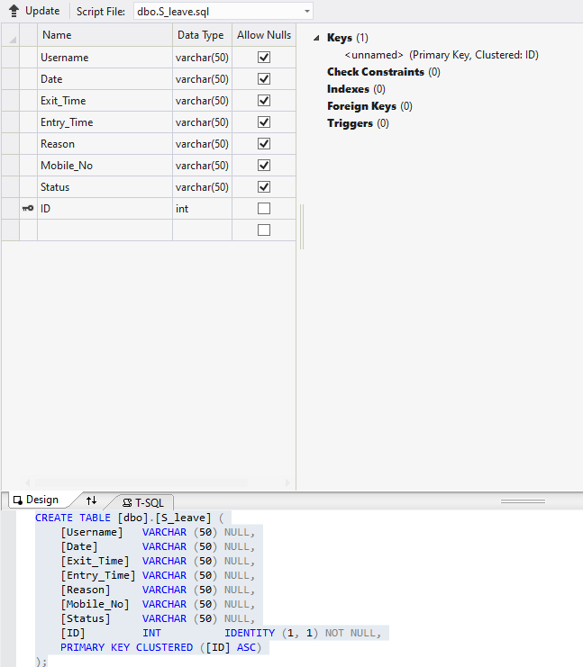
Short Leave Table In Database

Slide 15
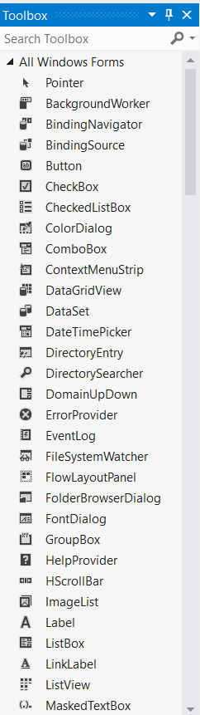
Interface Design
Visual Studio is installed to create interface
Controls of windows form are used for interface

Slide 16
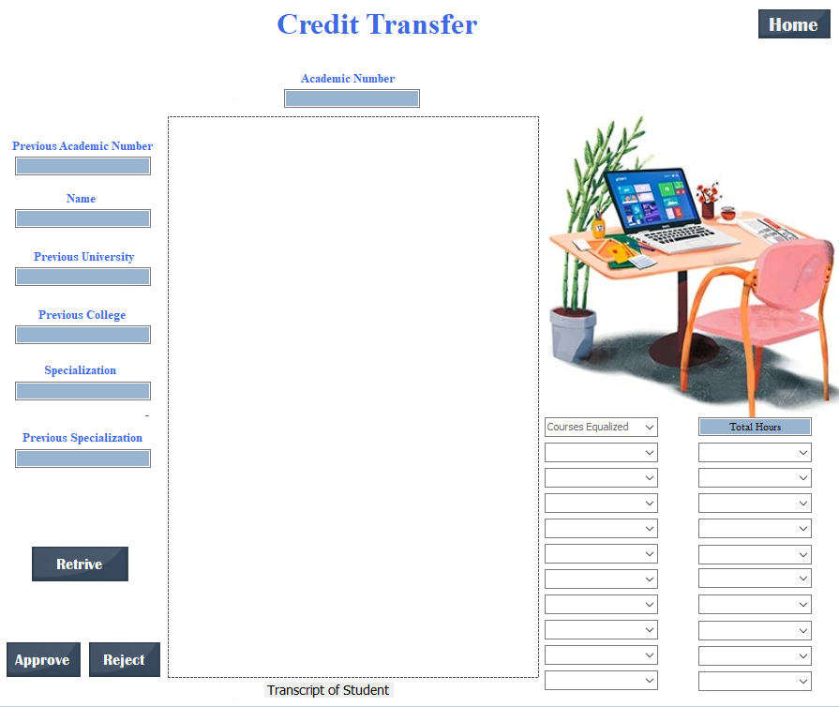
Interface Of Credit Transfer (Fill Equalization)

Slide 17
Implementation
C# is used for implementing the processes and to connect front-end with back-end
SQL queries are written to store and fetch data to and from database
E-mails are programmed and sent by using the C# programming

Slide 18
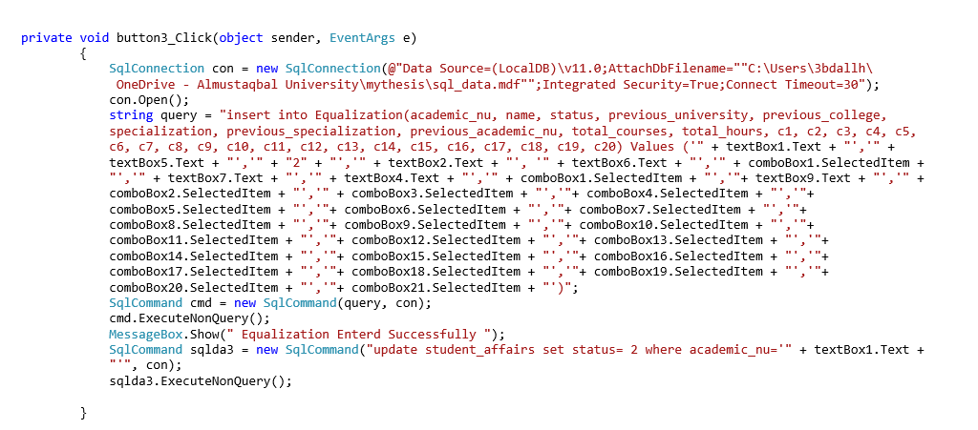
Sample Code (Approve Equalization)

Slide 19
Testing
White -box testing
All the activities and sub-processes inside each module are tested
Test cases are developed and implemented
Black-box testing
The working of the whole system is checked at once

Slide 20
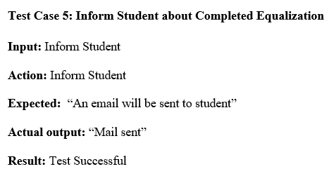
Test Case (Inform Student)

Slide 21
Future Work
Remaining modules will be implemented
Other processes of the university will be considered for implementation
Administration side will be included in the system

